Slide 1
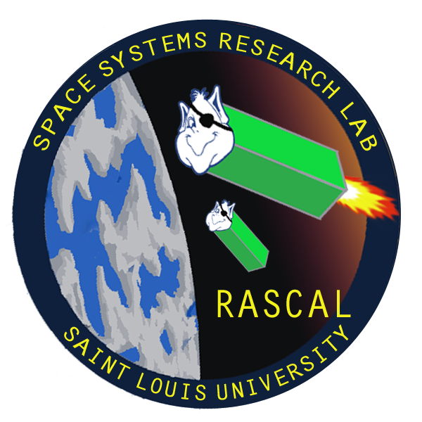



Rascal: Rendezvous and Proximity Operations
Team Bravo
Jennifer Babb
Bryant Gaume
Tom Moline
Tyler Olson
Nate Richard
First Semester Presentation
December 3, 2013

Slide 2
Group Organization
Project Overview
Mission Success Criteria
Design Constraints
Mission Architecture
CONOPS
Risk Assessment
Schedule
Conclusion

Slide 3
Group Organization
Group Member | Position
Jennifer Babb
Bryant Gaume | Structures Engineer, Propulsion Engineer
Tom Moline | Program Manager, Attitude Determination and Control Engineer
Tyler Olson | Power Engineer
Nate Richard | Communications Engineer

Slide 4
Group Organization
Project Overview
Design Constraints
Mission Architecture
CONOPS
Risk Assessment
Schedule
Conclusion

Slide 5
Key Mission Definitions
As proposed, the Rascal mission consists of a spacecraft capable of demonstrating key proximity operations.
Spacecraft proximity operations consist of orbital maneuvers made relative to a resident space object, such as:
Proximity operations have also been tagged by NASA as an enabling technology for future NASA missions
Proximity Operation Term | Definition
Stationkeeping | Maintaining a set relative displacement between two space objects for a period of several orbits
“Escape” Maneuver | Performing an orbital maneuver that increases the relative displacement between two space objects
Rendezvous | Performing an orbital maneuver that decreases the relative displacement between two space objects within a set distance for a period of several orbits
Resident Space Object | Any satellite or space debris residing in an orbit around Earth

Slide 6
Mission Summary

